Slide 1
AWS TranSlatE on SLaCK
By Furucrm-Dung-Haruji
Email: dung.nguyen@furucrm.com

Slide 2
Introduce
Goal: Intergating AWS Translate on Slack
Tools:
Vscode: using python
IntelJ: developing Spring boot
AWS Services: API Gateway, Lambda, EC2, AWS Translate

Slide 3
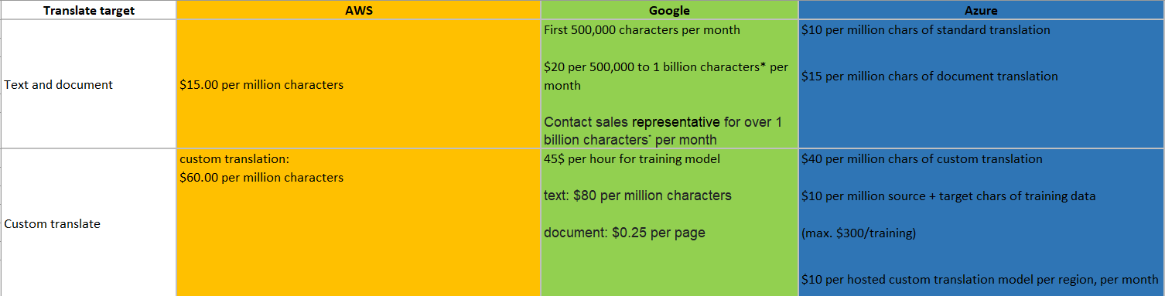
Cloud Translate Price

Slide 4
Case study:
Reduced time required for employee awareness surveys
Instantly translate the information stored on your website
Utilize Amazon Translate for services provided to customers
Another stud case: https://www.successglo.com/case-studies/

Slide 5
Developing Path:
Có 2 hướng để giải quyết vấn đề:
Directly :Slack Bot send translating request directly to Lambda to get translated result.
Indirectly :Slack Bot send translating request to get translated result via a medium server

Slide 6
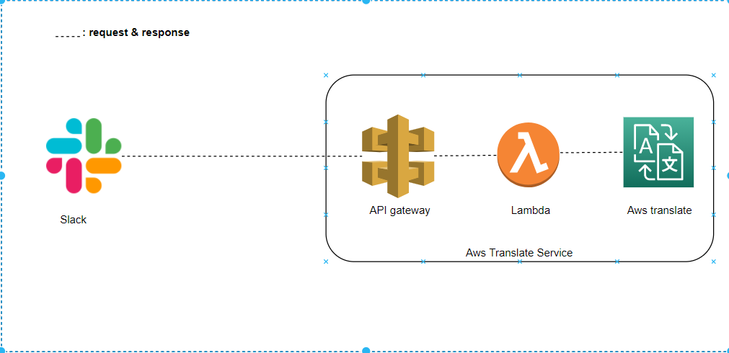
Developing Path: Directly (Diagram)

Slide 7
Developing Path: Directly (Flow)
1. Slack type /translate hello
2. Lambda received translate request from Slack
3. Lambda create and start Translate thread
4. Lambda response "translating...“
5. Translate thread translate => konnichiwa
6. TranslateThread response to Slack Notice: After sending request from Slack Bot 3 seconds, It will automatically return command error “operation_timeout” => response first then send result later via sending message Slack Api.

Slide 8
Developing Path: Directly (Dev)
Environment: Python lambda on VScode
Requirement:
+ Vscode
+Python
+ Installed WSL on OS. Ref: Link 1,link 2
+ Aws toolkit plugin : guide,create SAM app
Command to run:
Build container: SAM build --use-container
Mount and run container: SAM local start-api --host localhost --port 123
Use ngrok to publish port 123 to slack app in an hour.

Slide 9
Lambda’s mechanism
Lambda will sleep/suspend/killed current thread and its childlike thread after returning response in most case.
As result, creating childlike thread to response to Slack bot is unstable.
Question: How to call thread from Lambda and send translate result stably?

Slide 10
Developing Path: Directly (Solution 1)
Solution 2: Use Step Functions State Machine
Pro:
Require small budget
Fast to dev/deploy in short term
Con:
Hard to develop in long term due to distribute project to places on AWS

Slide 11
Developing Path: Directly (Solution 2)
Solution 1: Move to Indirectly Developing Path Pro: - Easily develop project as ease in short and long term. Con: - Adding budget for running EC2

Slide 12
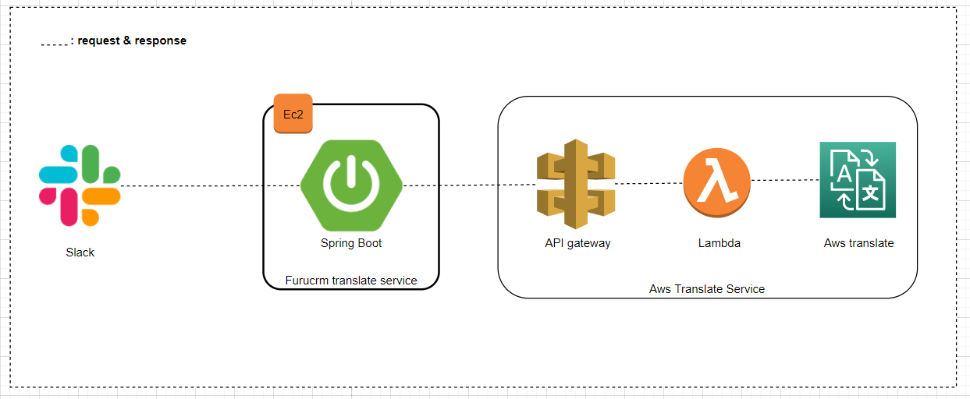
Developing Path: Indirectly (Diagram)

Slide 13
Developing Path: Indirectly (Flow)
1. ** On Slack, type /translate hello 2. Slack send a message to spring boot 3. Spring boot create a thread to process translating later 4. Spring boot response “translating...” 5. Spring boot translate and send result via slack’s sending message API
**: after 3 seconds, Slack will throw error on client if have no response

Slide 14
Prepare: EC2
Go “EC2” from search box at top of Aws Management console
Choose EC2 instance, get hostname from “Public IPv4 DNS” save to notepad for configging “Resquest URL” in slack app later

Slide 15
Step 1: Create slack bot
Go to Slack Api site
Click Create App
Choose from scratch
Choose a name for Slack App/Bot
Choose a workspace from “Pick a workspace to develop your app in”, so app will be actived in workspace
Click create app.
From left menu, choose “Slash Commands” and choose “create new command”
Choose name for command

Slide 16
Step 1: Create slack bot (cont)
Choose “request URL” to which will be sent when command is used, use saved hostname of EC2.
Choose “Short decription” and “Usage hint”
Click save
From left menu, choose “OAuth & Permissions”
Move page to “Scope”, Add chat:write
Move space to top, click “Reinstall to Workspace”
From left menu, choose “Install App” then save “Bot User OAuth Token” to notepad to use later as “SLACK_BOT_TOKEN”
From left menu, choose “Basic information” then save “Verification Token” to notepad to use later as “SECRET_KEY ”

Slide 17
Step 2: config Aws IAM
Go to AWS Management Console on website
Go to IAM, create role
Choose “Aws Service”, choose “Lambda”,
Choose “next: Permission”,
On “Attach permissions policies”, attach translateReadOnly,CloudWatchLogsFullAccess
Click “Next : tags”
Click “Next: preview”
Choose name (ex: “translate_user”) for role name
Click “create role”

Slide 18
Step 3: config Aws Lambda
Go Aws Lambda from search box at top of Aws Management console
Click “Create function”
Choose “Author from scrath”
Choose “Function Name” (ex:”TranslateFunc”)
Choose Runtime for developed language, choose python 3.8
On permission, choose “Use an existing role” for “Execution Role”
Choose “Translate_user” from dropbox
Choose “Create funtion”
Write code on “Lambda_function” and click “Deploy”

Slide 19
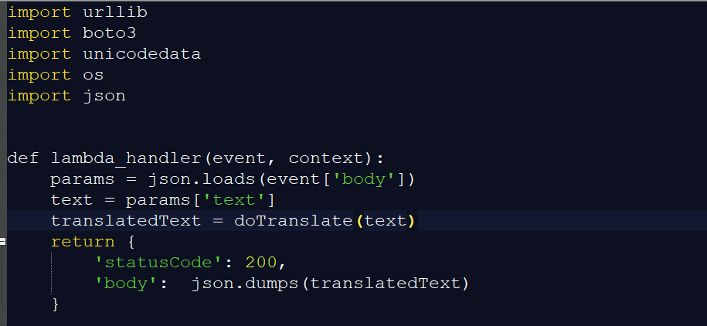
Step 3: config Aws Lambda (cont)

Slide 20
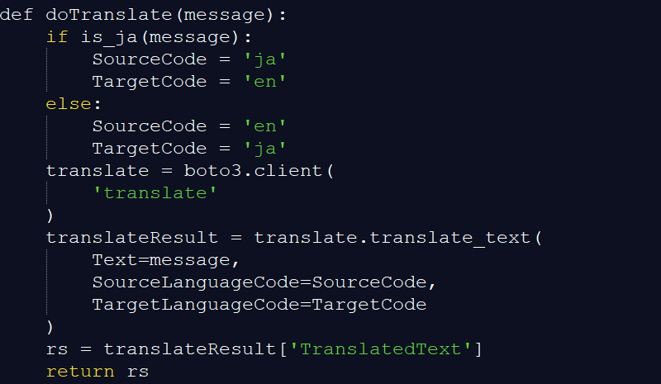
Step 3: config Aws Lambda (cont)

Slide 21
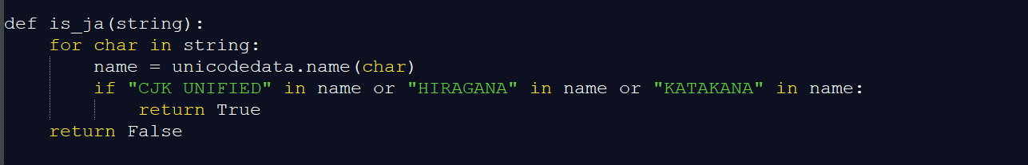
Step 3: config Aws Lambda (cont)

Slide 22
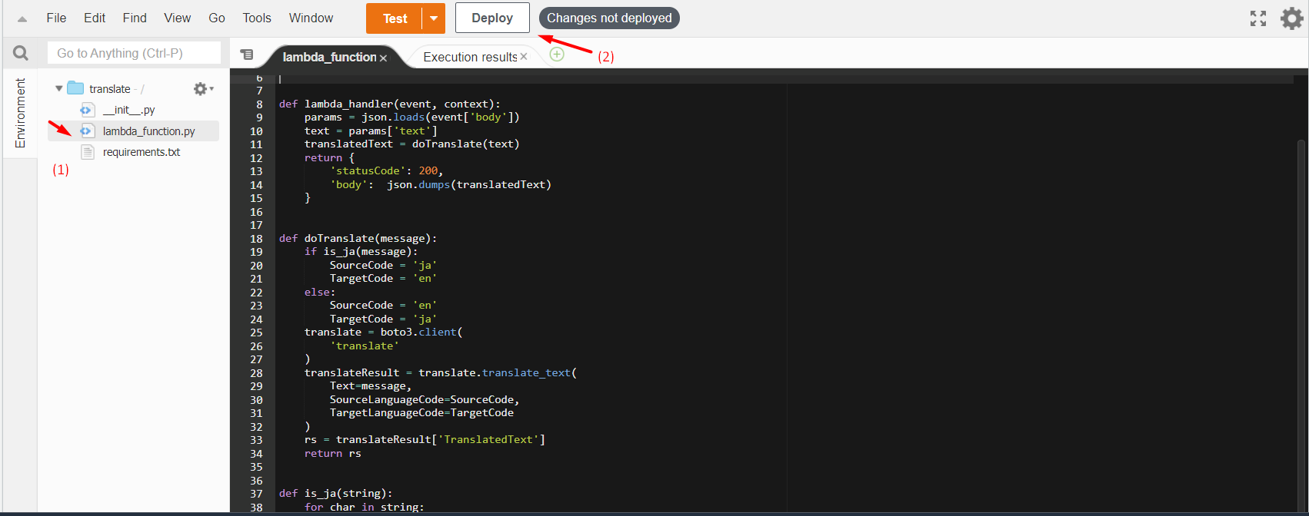

Slide 23
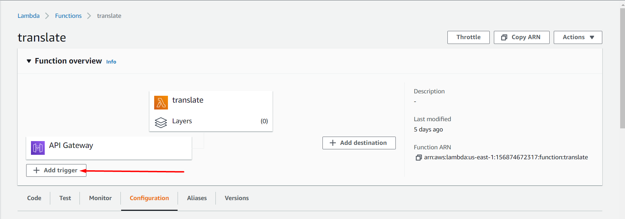
Step 3: Add trigger to Lambda

Slide 24
Step 3: Add trigger to Lambda (Cont)
On “Trigger configuration”, choose “API Gateway”
At “Api”, choose “Create an Api”
“Api type”, choose HTTP API
“Security”, choose “Open”
Click “Create”

Slide 25
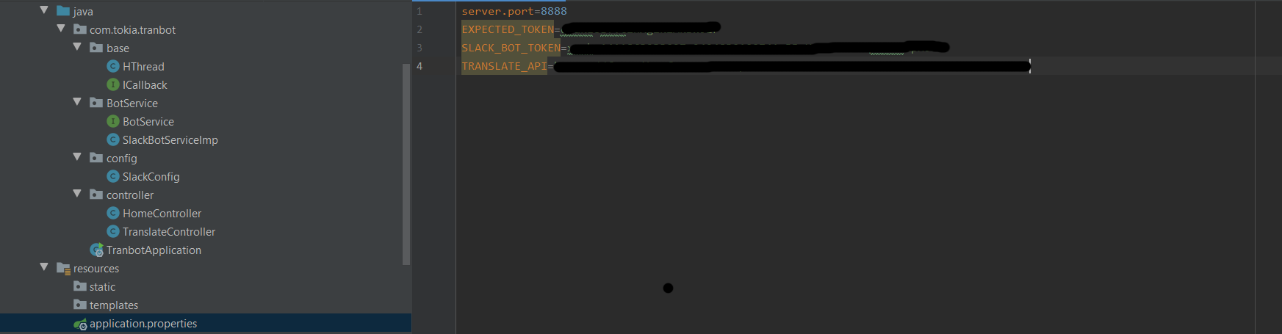
Step 4: prepare spring boot

Slide 26
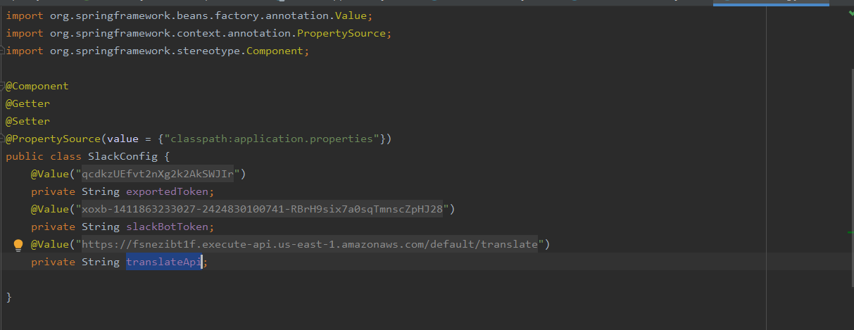
Step 4: prepare spring boot (cont)

Slide 27
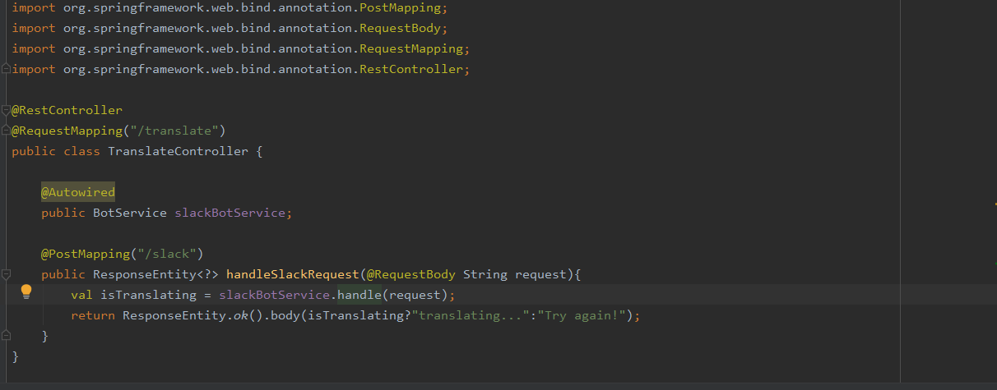
Step 4: prepare spring boot (cont)

Slide 28
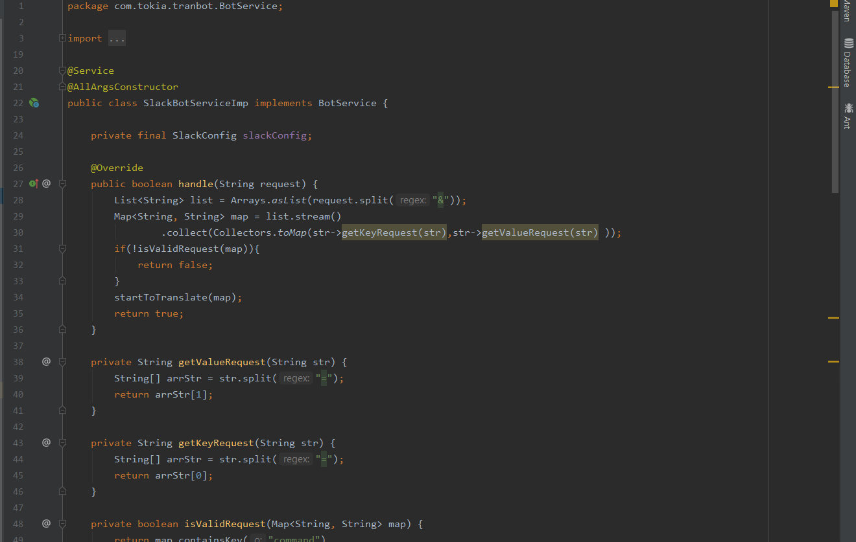

Slide 29
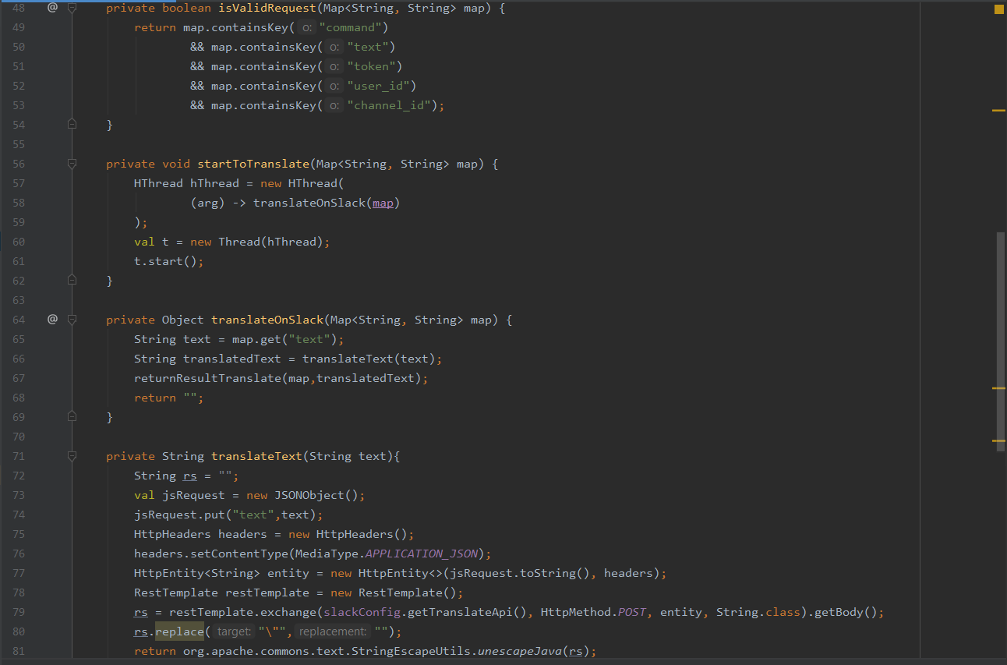

Slide 30
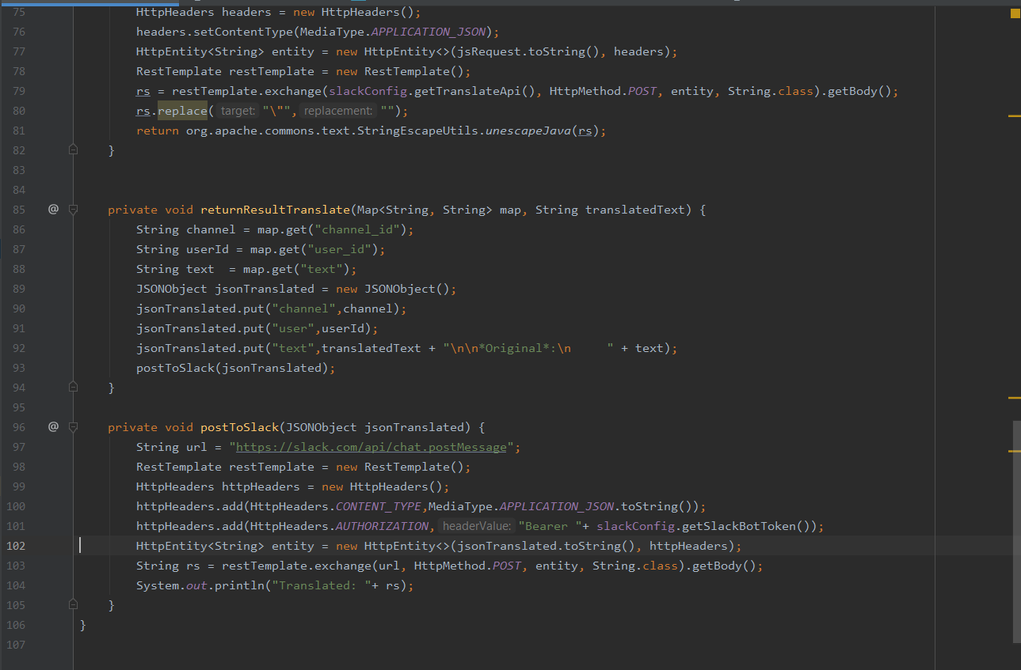

Slide 31
Reference
Intergate Aws Translate on Slack (Japanese)
Create Slack bot
Dev Slack bot locally
Debugg AWS lambda on vscode
Change default runtime handler
Source: Github

Slide 32
Thank you for taking time with me ! ☺

